Slide 1

HOW TO SAVE LIVES?
Tom Novak
Max Basov
PI Sigal Kaplan

Slide 2
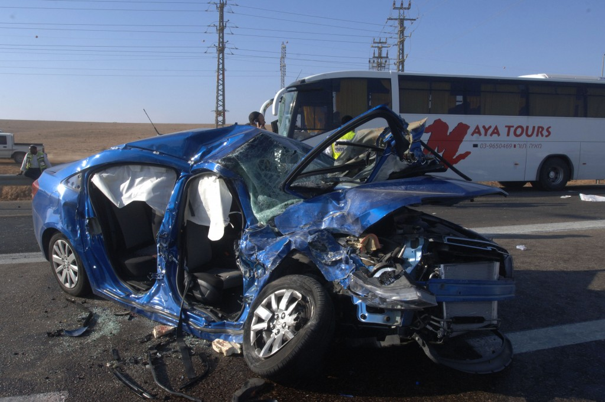

Slide 3
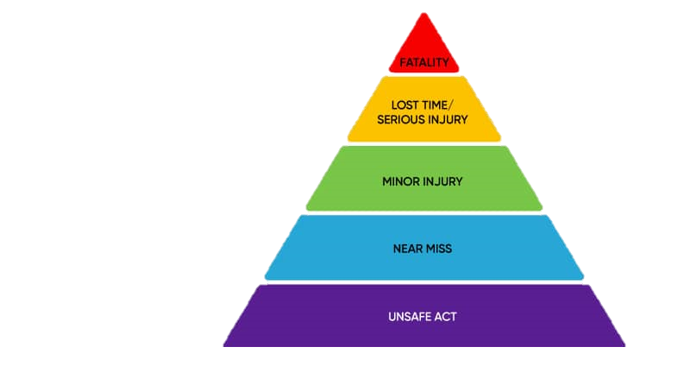
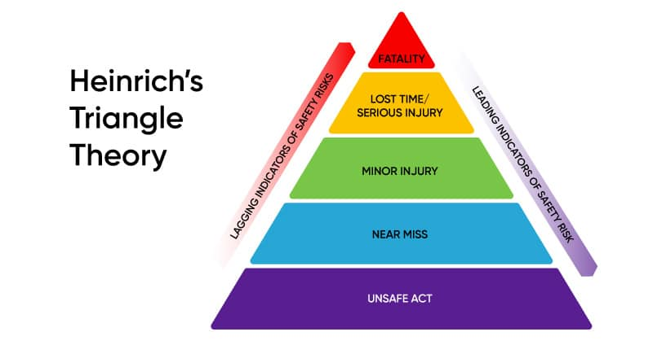
BACKGROUND
In 2021, 1.3 million people were killed in road traffic accidents around the world
Notes:
In Israel 361

Slide 4
VISION ZERO
Worldwide
Multi-national road traffic safety project
Aims to eliminate all traffic fatalities and severe injuries
Started in Sweden in 1997 and spread to dozens of countries
New York City
Since 2014 1.6B$ were invested
Focus on enforcement, engineering, legislation and education
Notes:
For the first dot: "Life and health can never be exchanged for other benefits within the society”

Slide 5
RESERCH HYPOTHESIS
Are transportation infrastructure improvements and changes in traffic law enforcement effective in reducing the severity and frequency of traffic accidents?

Slide 6
SO FAR
A paper from 2021 tried to predict traffic accident
In Beijing
Based on road networks, traffic accidents, taxi GPS, meteorological data and POI’s
Used Deep spatio-temporal graph convolutional network
Le Yu, Bowen Du, Xiao Hu, Leilei Sun, Liangzhe Han, Weifeng Lv,
Deep spatio-temporal graph convolutional network for traffic accident prediction,
Neurocomputing, Volume 423,2021,Pages 135-147,ISSN 0925-2312

Slide 7
SO FAR
TBD
A paper from 2020 tried to predict traffic accident
In Beijing
Based on road networks, traffic accidents, taxi GPS, meteorological data and POI’s
Used Deep spatio-temporal graph convolutional network
Le Yu, Bowen Du, Xiao Hu, Leilei Sun, Liangzhe Han, Weifeng Lv,
Deep spatio-temporal graph convolutional network for traffic accident prediction,
Neurocomputing, Volume 423,2021,Pages 135-147,ISSN 0925-2312

Slide 8
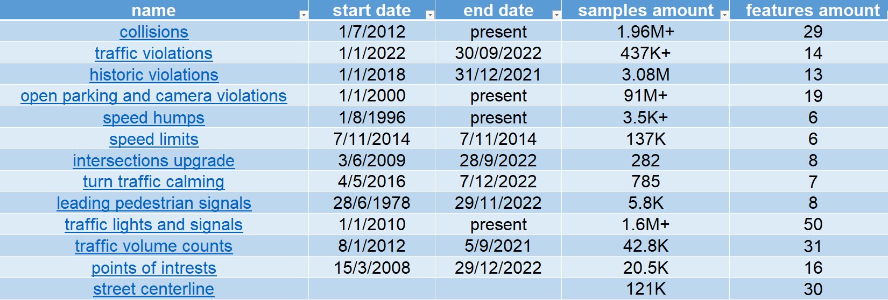
OUR DATA

Slide 9
OUR SOLUTION
Create a model to evaluate the effectiveness of engineering and enforcement aspects of Vision Zero program in NYC
We chose to use TSGCN (temporal spatial graph convolutional network) as our framework

Slide 10
THANK YOU

